Slide 2
Radiation Therapy- Section D

Slide 3
Objectives
Understanding Radiation Therapy- Section D
Clinical examples for better understanding
Knowledge Check
Exercises

Slide 4
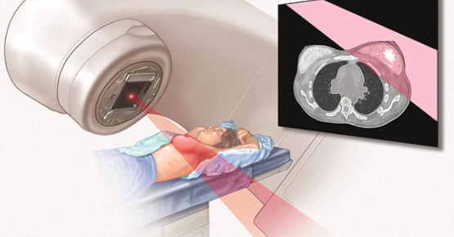
Radiation Therapy
Radiation Therapy is defined as a treatment that contains the radiation procedures performed for cancer treatment.
Character meanings are described below-
Third character defines root type, which is the basic modality.
Fifth character further specifies treatment modality.
Sixth character defines the radioactive isotope used, if applicable.
Seventh character is a qualifier, and is not specified in this section.

Slide 5
Radiation Therapy
Root Type
The third character defines the treatment modality as root type. Examples are Brachytherapy and Stereotactic Radiosurgery.
Four different root types are used in this section, as listed below-
0: Beam Radiation- Beam radiation is the solar radiation received from the Sun without having been scattered by the atmosphere.
1: Brachytherapy- Brachytherapy is a form of radiation therapy where a sealed radiation source is placed inside or next to the area requiring treatment
2: Stereotactic Radiosurgery- Stereotactic surgery is a minimally invasive form of surgical intervention that makes use of a three-dimensional coordinate system to locate small targets inside the body and to perform on them some action such as ablation, biopsy, lesion, injection, stimulation, implantation, radiosurgery,
Y: Other Radiation- Other Radiation includes Intraoperative Radiation Therapy, Hyperthermia, Contact Radiation, Isotope Administration etc.

Slide 6
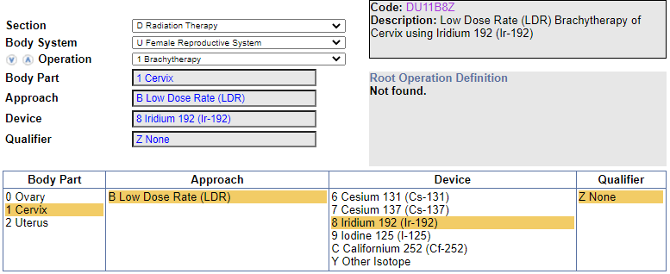
Clinical Example 1
LDR Brachytherapy of cervix using Iridium 192
Code: DU11B8Z {Low Dose Rate (LDR) Brachytherapy of Cervix using Iridium 192 (Ir-192)}
Coding Navigation:

Slide 7
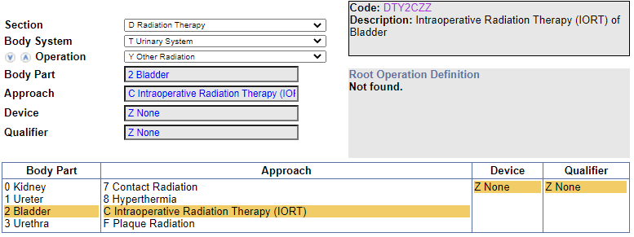
Clinical Example 2
Intraoperative radiation therapy (IORT) of bladder
Code: DTY2CZZ (Intraoperative Radiation Therapy (IORT) of Bladder)
Coding Navigation:

Slide 8
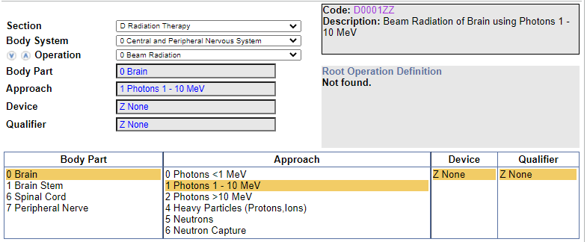
Knowledge Check 1
What is the code assignment for 8 MeV photon beam radiation to brain?
Codes: D0011ZZ (Beam Radiation of Brain using Photons 1 - 10 MeV)
Code Navigation:

Slide 9
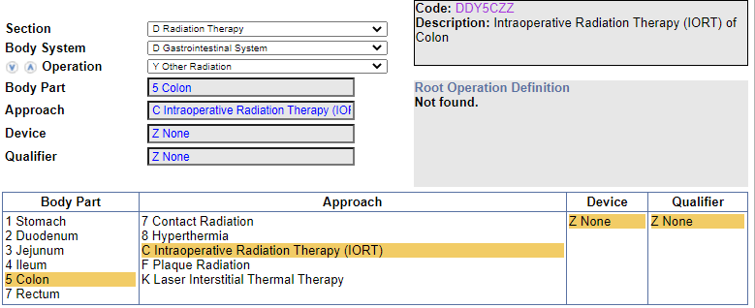
Knowledge Check 2
What is the code assignment for IORT of colon, 3 ports?
Code: DDY5CZZ (Intraoperative Radiation Therapy (IORT) of Colon)
Code Navigation:

Slide 10
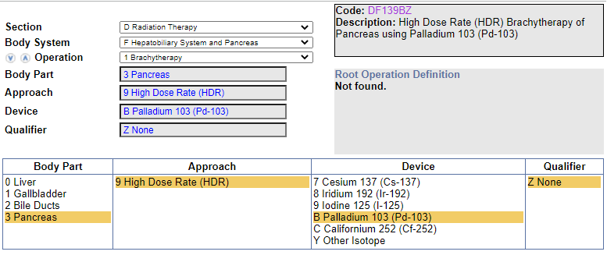
Exercise 1
What is the code assignment for HDR Brachytherapy of prostate using Palladium 103?
Code: DF139BZ [High Dose Rate (HDR) Brachytherapy of Pancreas using Palladium 103 (Pd-103)]
Code Navigation:

Slide 11
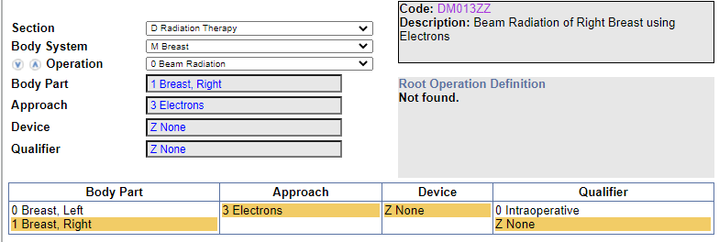
Exercise 2
What is the code assignment for Electron radiation treatment of right breast, custom device?
Code: DM013ZZ (Beam Radiation of Right Breast using Electrons)
Code Navigation:

Slide 12
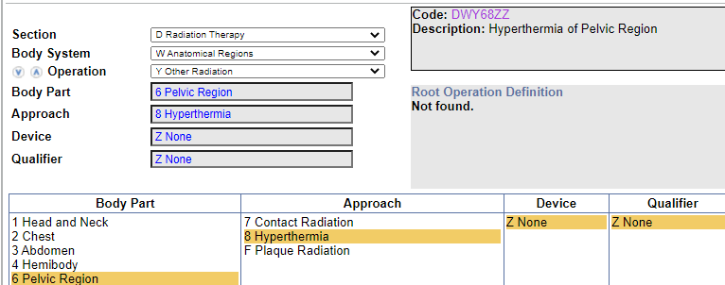
Exercise 3
What is the code assignment for Hyperthermia oncology treatment of pelvic region?
Code: DWY68ZZ (Hyperthermia of Pelvic Region)
Code Navigation:

Slide 13
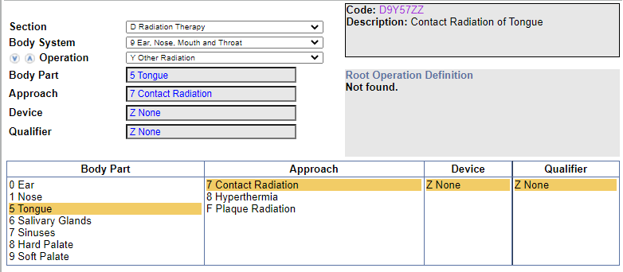
Exercise 3
What is the code assignment for Contact radiation of tongue?
Code: D9Y57ZZ (Contact Radiation of Tongue)
Code Navigation:

Slide 14
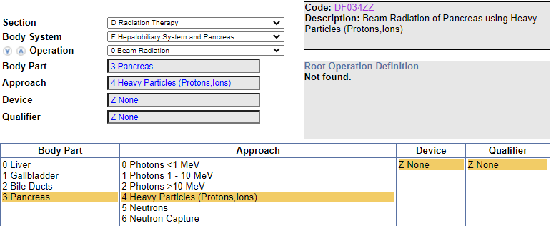
Exercise 4
What is the code assignment for Heavy particle radiation treatment of pancreas, four risk sites?
Code: DF034ZZ [Beam Radiation of Pancreas using Heavy Particles (Protons,Ions)]
Code Navigation:

Slide 15
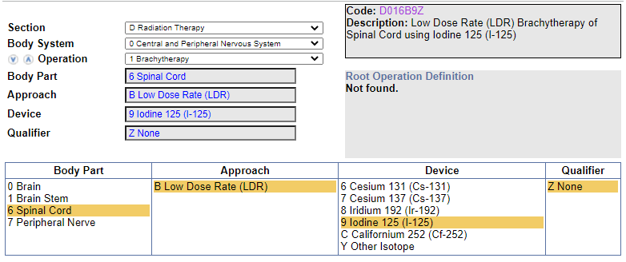
Exercise 5
What is the code assignment for LDR brachytherapy to spinal cord using iodine?
Code: D016B9Z [Low Dose Rate (LDR) Brachytherapy of Spinal Cord using Iodine 125 (I-125)]
Code Navigation:

Slide 16
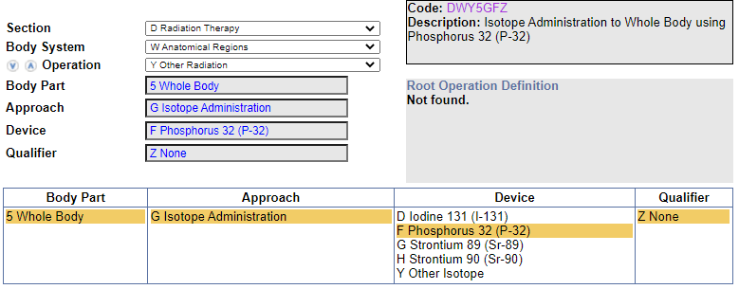
Exercise 6
What is the code assignment for Whole body Phosphorus 32 administration with risk to hematopoetic system?
Code: DWY5GFZ [Isotope Administration to Whole Body using Phosphorus 32 (P-32)]
Code Navigation:

Slide 17
Thank You

